Slide 1
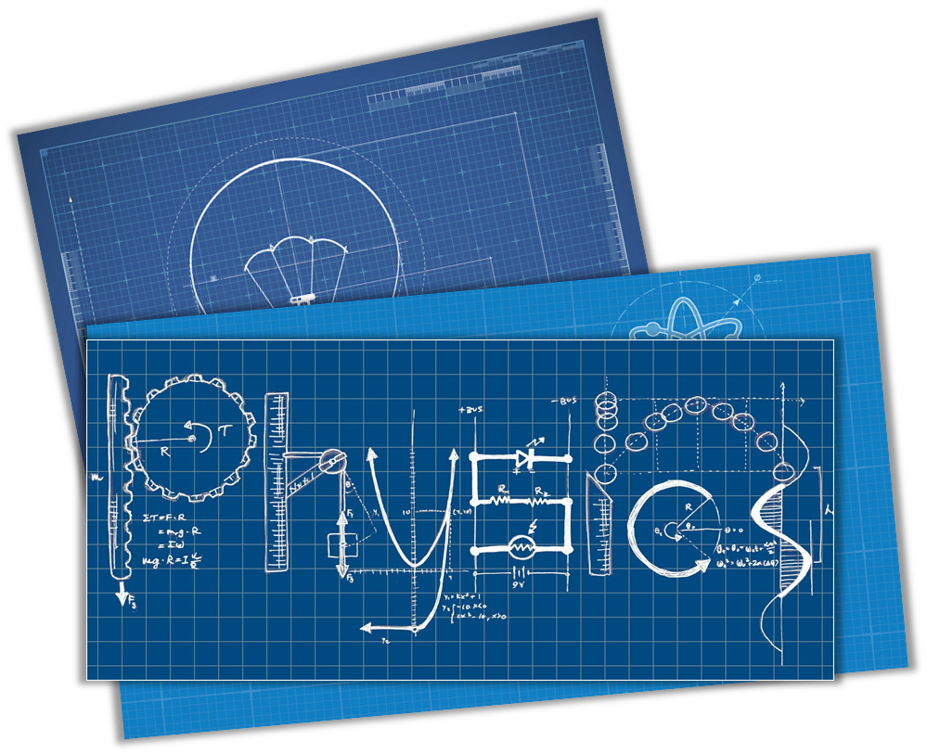
Team “ YAIY “
PHYSICS PROJECTS​

Slide 2

Our team

Slide 3
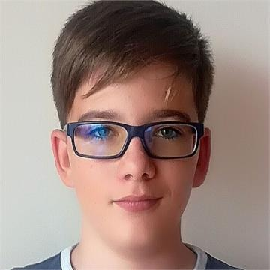
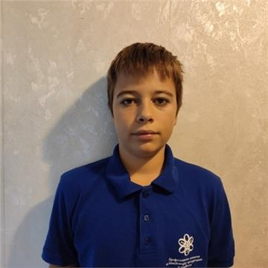
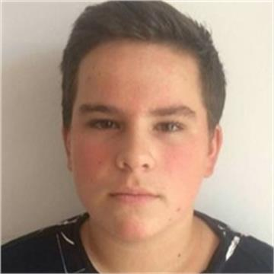
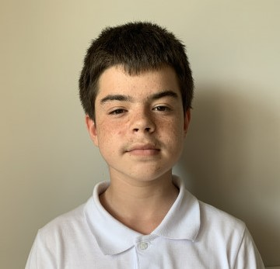
Our team
Andrey Mutlu 9V
Scrum Trainer
Yoan Todorov 9V
Backend Developer
Yoan Panov 9A
Backend Developer
Ivan Dadakov 9A
Quality engineer

Slide 4

Stages of work

Slide 5



Stages of work
1
2
3

Slide 6

Our idea

Slide 7
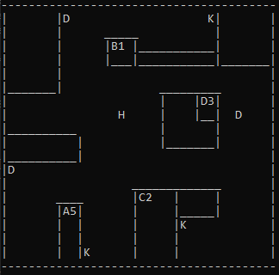
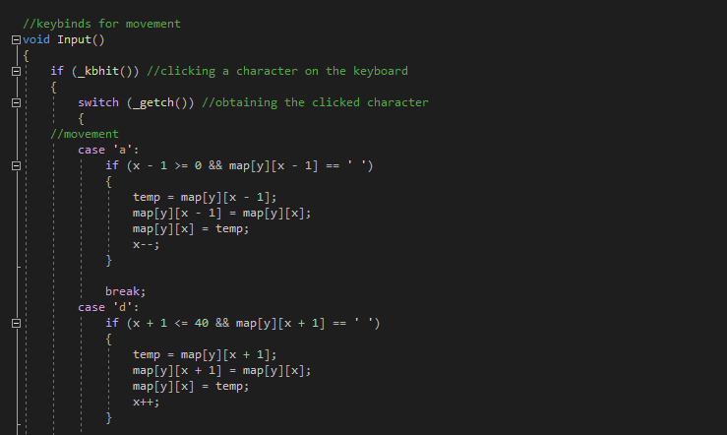
Our idea
Megamind Clash

Slide 8

Technologies

Slide 9












Technologies

Slide 10

Our game

